Slide 1
Contributor Header changes

Slide 2
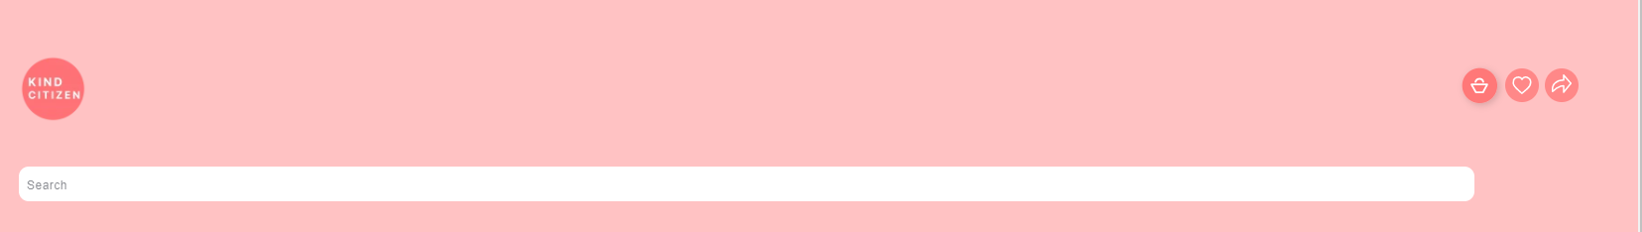
class=“c2Coloured-bg" - entire header
class="top-bar grid" - header grid
class="header-icons" - The 4 logo (kind citizen, cart, wishlist, share)
class="grid__item small--one-third" - left grid
class="site-header grid medium-up--grid--table"
id="HeaderLogoWrapper"

Slide 3
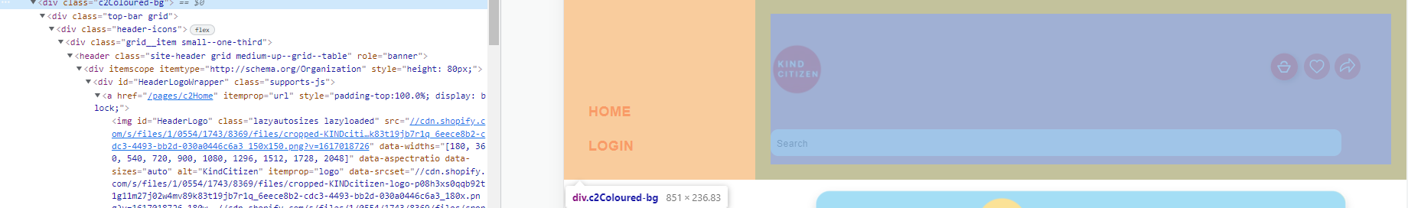
class=“c2Coloured-bg" - entire header

Slide 4
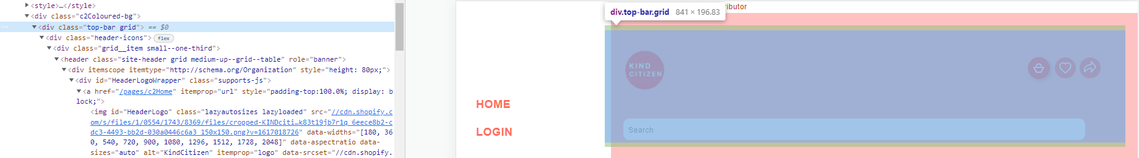
class="top-bar grid" - header grid

Slide 5
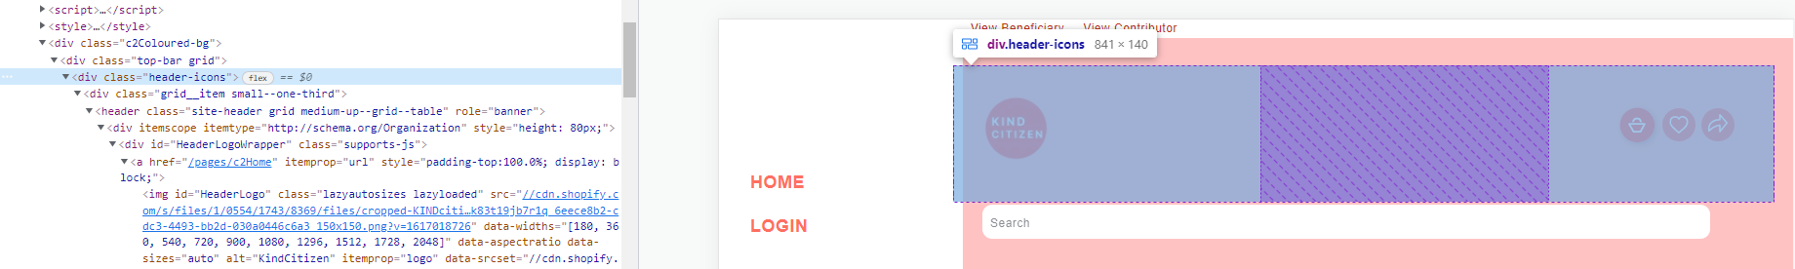
class="header-icons" - The 4 logo (kind citizen, cart, wishlist, share)

Slide 6
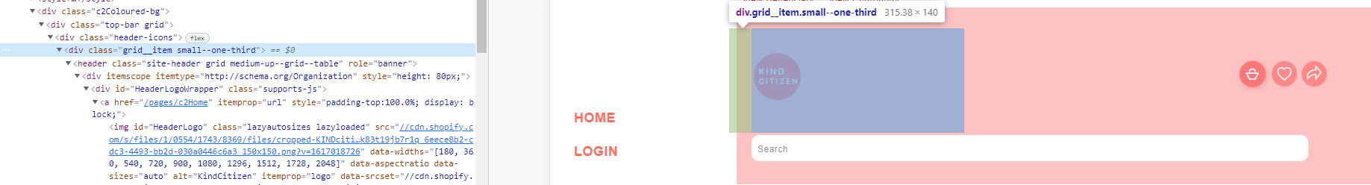
class="grid__item small--one-third" - left grid

Slide 7
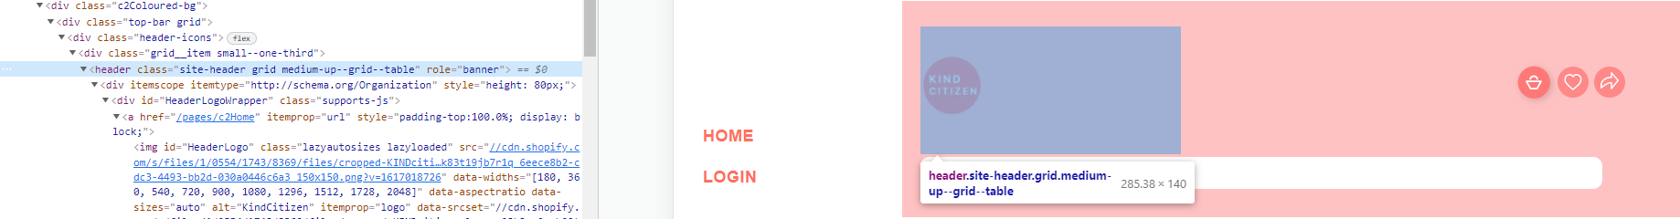
class="site-header grid medium-up--grid--table"

Slide 8
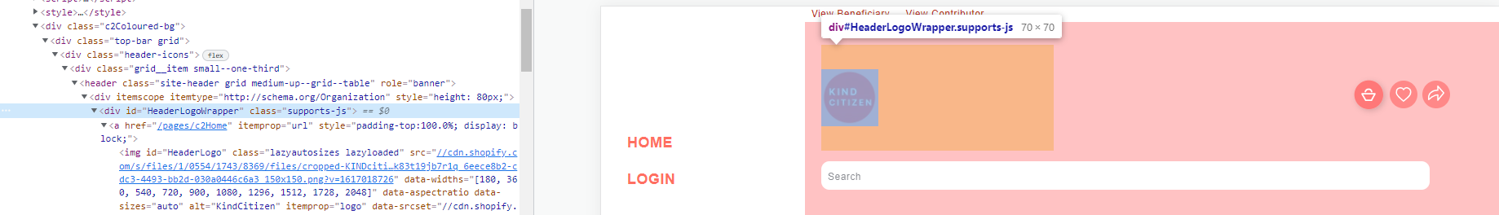
id="HeaderLogoWrapper"

